Slide 1

Adaptive Learning for Educational Recommendation System
Yu Tang
Automatic Control Laboratory
29. January 2024 ETH Zurich
Supervisors:
Dr. Alberto Padoan
Dr. Mathias Hudoba de Badyn
Scott Sussex
Prof. Dr. John Lygeros
Notes:
Share with you some insights of education recommendation system. Today is like an overview of existing techniques, and on top of that, collaborated with Prof. gerd, we have new dataset regarding students taking physics courses throughout many years, and we want to discuss if this dataset could be useful for building a recommendation system.

Slide 2
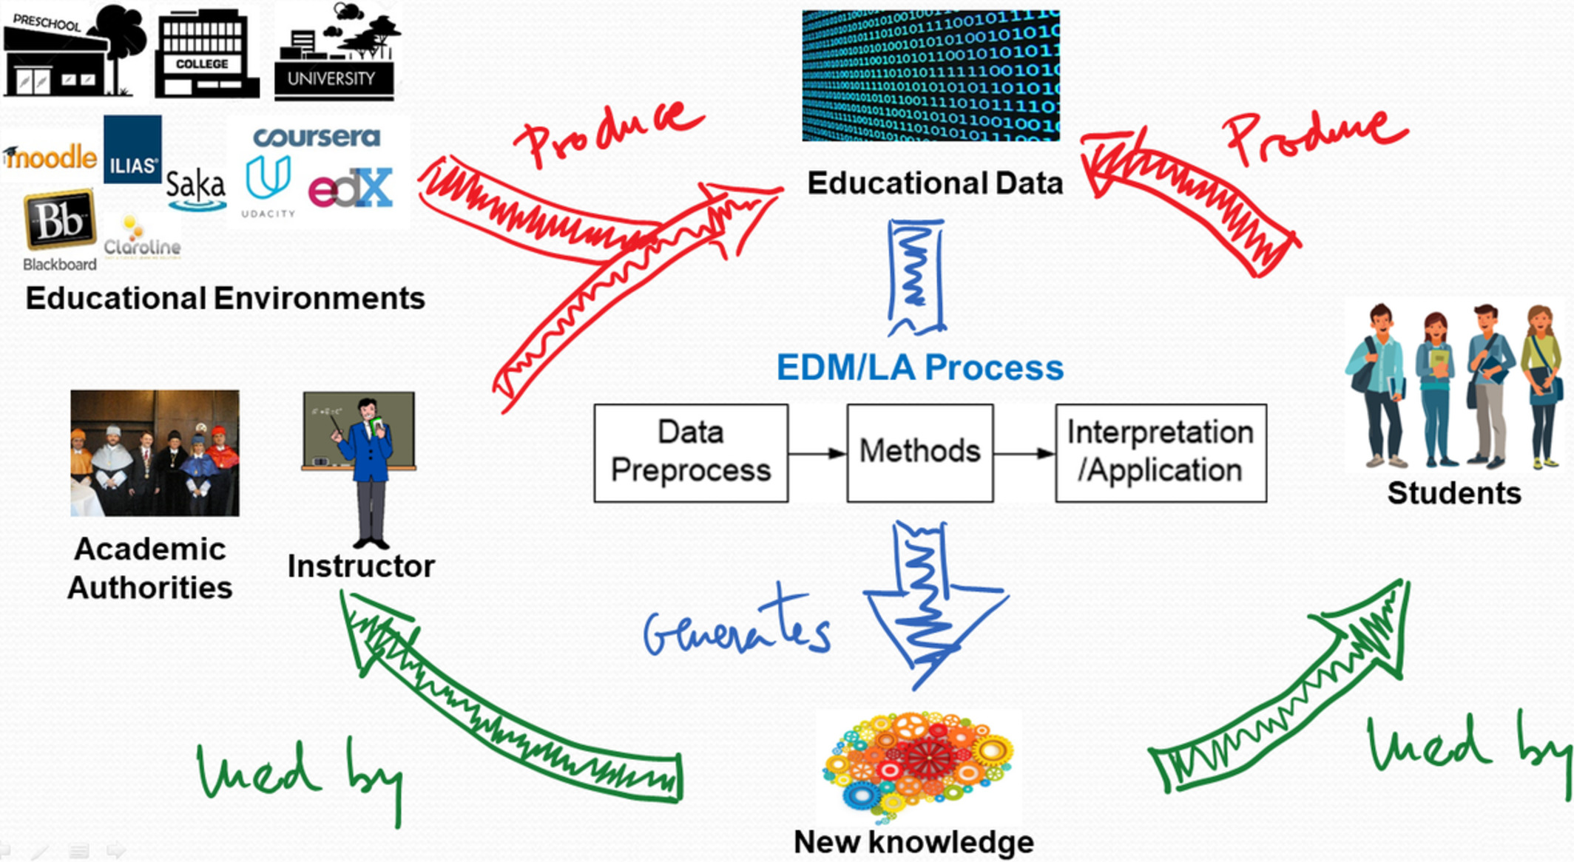

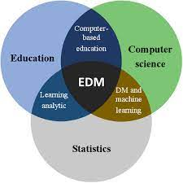
Educational data mining (EDM)
Notes:
Motivation: dataset that recorded students taking exam, exercise, and we want to know if we can do personalized learning based on this dataset. This is under the big field of educational data mining, where you have many different datasets, and it could involve data analysis, machine learning methods to utilize those datasets

Slide 3


Intelligent tutoring system: Education recommender
Knowledge state estimator
Dataset Pre-processing
Virtual student
Online education platform
Real student
Notes:
Goal: personalized learning. To achieve this goal, basically the workflow is : analyze the dataset, estimate students knowledge state towards the concepts in a course, be able to predict their future performance. After that, we should train a recommendation policy in recommender system and then this recommender system further interact with students to improve the policy. Two ways: 1. no online data, we can only get feedback from virtual student (student knowledge estimator), OR, interact with real students. achieve the goal of personalized learning. As you can see, there is some RL stuff involved, but I won’t talk about this today. Today our focus is knowledge state estimator.

Slide 4
Agenda
LonCAPA dataset
Matrix factorization
Knowledge tracing
Conclusion and Future work

Slide 5
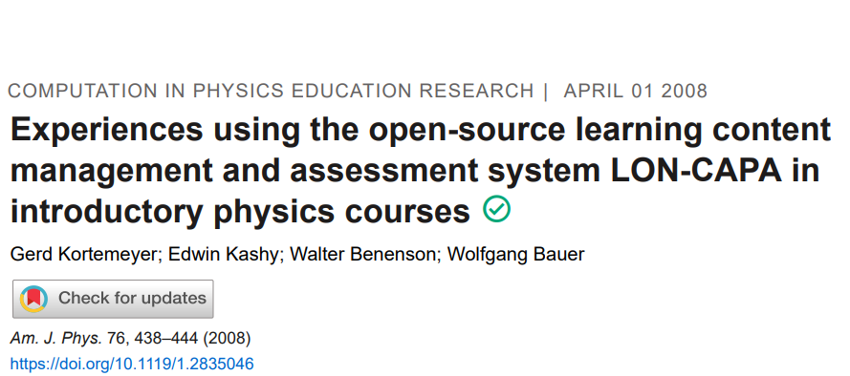
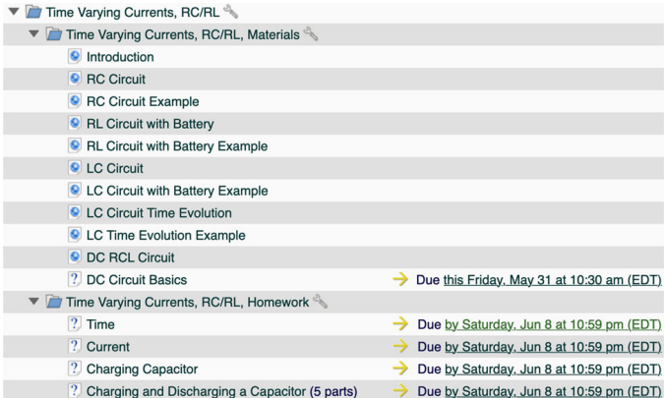
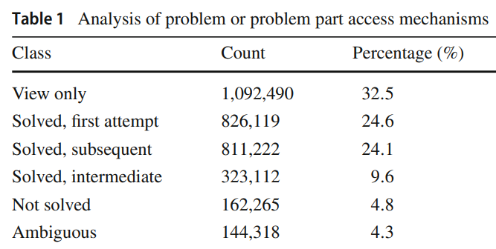
Notes:
Loncapa dataset, two scenarios: model-based MF and knowledge tracing. Knowledge tracing requires huge dataset (only for online learning), but actually in Loncapa, in conventional class room setting, we still have sufficient dataset to fit knowledge tracing

Slide 6
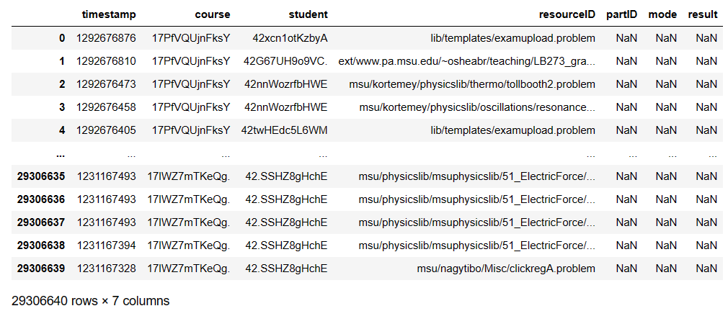
LONCAPA dataset
Homework
How many courses: 34
Three types of mode:
Graded by TA
Exam
Questions / Item (Q): For each course, the unique pair of ‘resourceID’ and ‘partID’ indicates the number of different questions
Latent Knowledge Concept (KCs)：N/A
Notes:
We find Graded by TA mode has only very small portion and we would discard it.

Slide 7
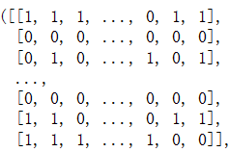
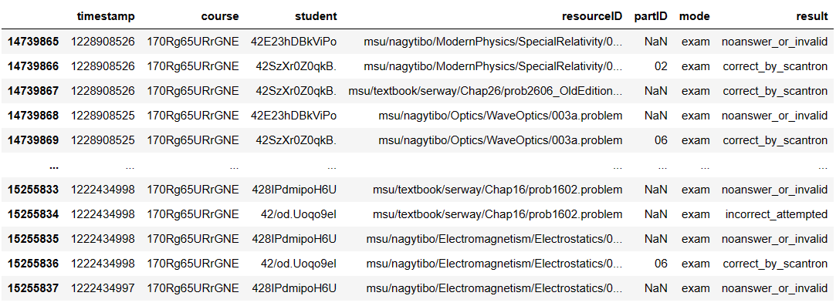
Exam mode (LonCAPA)
Notes:
Regarding exam mode (we would use matrix factorization), we can get student answers of different questions in an exam right/wrong (1/0). And we can convert these information into a matrix format.

Slide 8
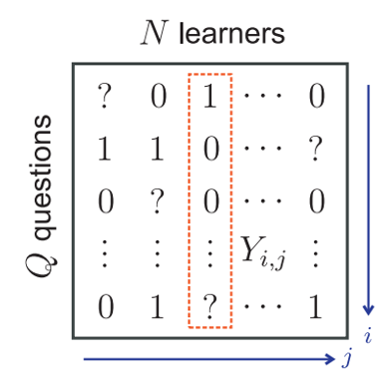
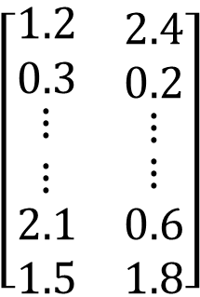
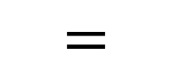
Matrix factorization for recommendation
$$\left[\begin{matrix}\begin{matrix}1.2 \\ 0.3 \\ \begin{matrix}⋮ \\ ⋮\end{matrix}\end{matrix} & \begin{matrix}\begin{matrix}\begin{matrix}2.4 \\ 0.2\end{matrix} \\ ⋮\end{matrix} \\ ⋮\end{matrix} \\ \begin{matrix}2.1 \\ 1.5\end{matrix} & \begin{matrix}0.6 \\ 1.8\end{matrix}\end{matrix}\right]$$
$$=$$
$$\left[\begin{matrix}\begin{matrix}−1.5 & 2.4 & −0.6\end{matrix} & \begin{matrix}⋯ & ⋯ & \begin{matrix}0.7 & 1.4 & −0.5\end{matrix}\end{matrix} \\ \begin{matrix}0.6 & 0.8 & 2.6\end{matrix} & \begin{matrix}⋯ & ⋯ & \begin{matrix}−0.2 & 2.7 & −1.7\end{matrix}\end{matrix}\end{matrix}\right]$$
Student knowledge matrix
Question-Response matrix
Question structure matrix
Characteristics
MF algorithms:
No temporal/dynamic information
Each student answers similar number of questions only once (e.g., midterm exam)
Might have missing entries
SVD
ALS
NMF
SPARFA
Notes:
Each row means a question and each column means a student. Once we have a response matrix, how can we use it to observe the students’ knowledge state
Use matrix factorization to decompose a matrix into 2 low-dimensional matrices to capture latent factors. One is question matrix, the other one is student matrix. Item matrix: latent relationship among questions. User matrix: student themselves “What is the student knowledge state towards each question or concept.”
The reason why we use MF is due to the characteristics of the dataset. For exam mode, no learning process involved

Slide 9
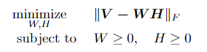
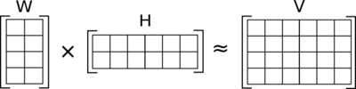
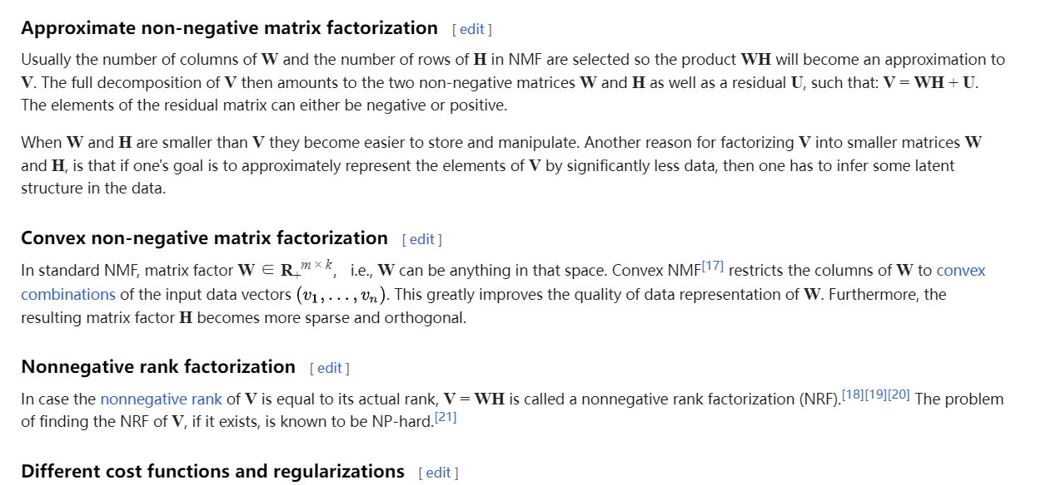
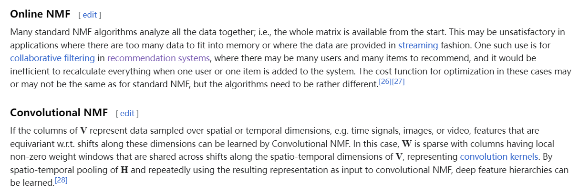
1. Non-negative matrix factorization (NMF)
In general, never obtain zero reconstruction error (sub-optimal)
Notes:
Our dataset is non-negative, binary, we could use this problem formulation. (generally used for feature extraction and dimensionality reduction )
Wiki search, There are tons of differnet algorithm, I will introduce the most general and popular one.
Btw, The amount of error usually depends on the dimension of W,H (how much portion of information you want to keep). In our scenario, refers to the estimated number of concepts. This is not given, this is a parameter to be found or tuned.

Slide 10
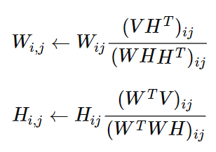
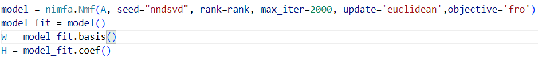
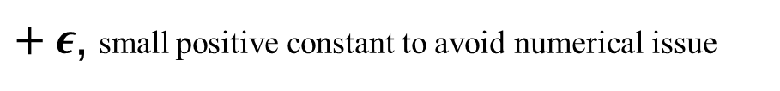
Algo.1 Multiplicative update rules for NMF
Iteratively update the elements of W and H
Open library: nimfa, sklearn.NMF
$+ ε$, small positive constant to avoid numerical issue
https://nimfa.biolab.si/nimfa.methods.factorization.nmf.html
https://scikit-learn.org/stable/modules/generated/sklearn.decomposition.NMF.html
Notes:
Don’t bother with how to derive this rule. It’s definitely sub-optimal, very efficient.
to minimize the Frobenius norm of the reconstruction error
Note that the updates are done on an element by element basis not matrix multiplication
Other variants: non-negative least squares solver, regularize W or H
this closed-form solution may not satisfy the non-negativity constraint, so further adjustments are made to ensure that the solution remains non-negative.

Slide 11
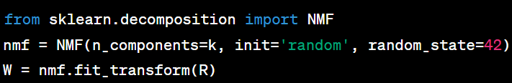
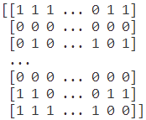
Algo.2 Non-negative least squares solver for NMF (Coordinate Descent)
non-negative least squares solver, regularize W and/or H
Thresholding
Binary Matrix Factorization (BMF)
Notes:
Two variables, fix one and update the other, and do the other way around.
I would say these two methods in general don’t make a big difference in terms of the results, at least when I ran it.
this closed-form solution may not satisfy the non-negativity constraint, so further adjustments are made to ensure that the solution remains non-negative.

Slide 12
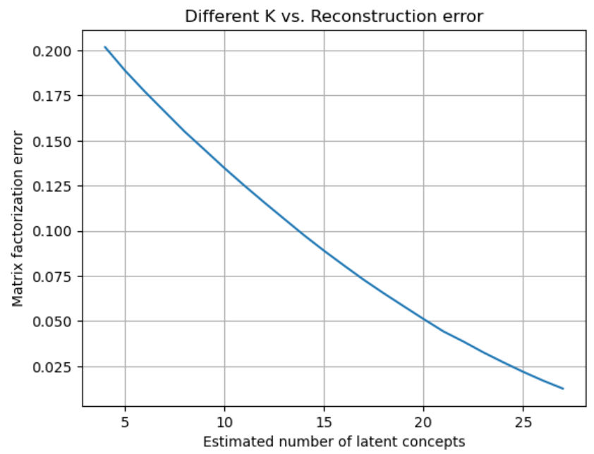
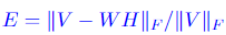
Different K vs. Reconstruction error
Lon-Course 1 ( 31 questions)
For each K, the reconstruction error is calculated by averaging 10 independent experiments
Notes:
And K is chosen depending on how much error you could accept.

Slide 13
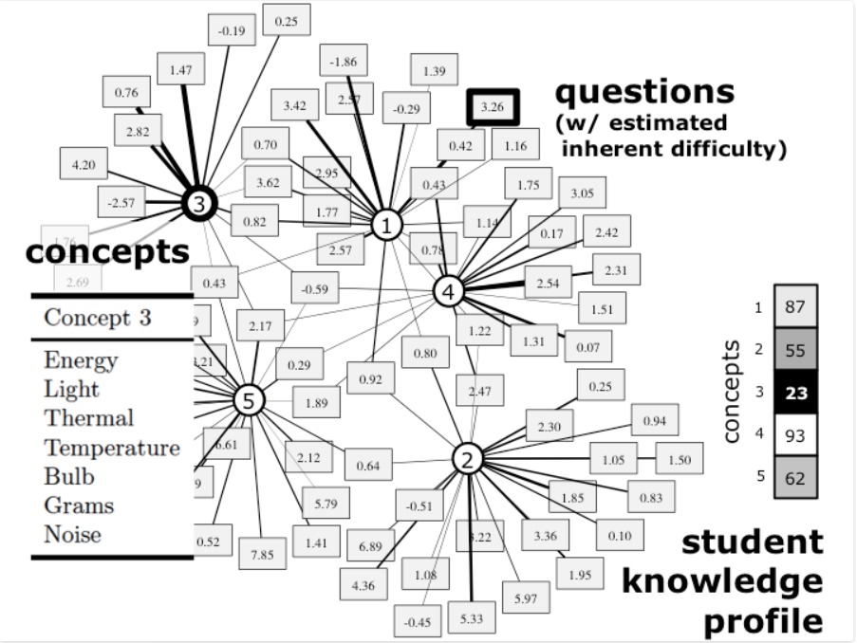
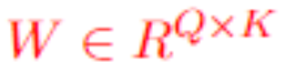
Interpretation of W
Notes:
Ok I still haven’t explained too much why we do this. We do MF because we want to find the low-dimensional feature.
If K is given in the dataset, we might be able to use it for cross-val. Not given, we could tune it on our own.

Slide 14
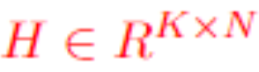
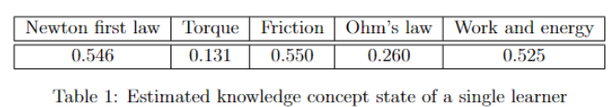
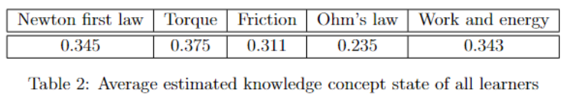
Interpretation of H
K=5
Notes:
What more important is H matrix. Student matrix, knowledge state towards concepts. Student state estimator for exam mode
Take one specific column, it can be viewed as the students mastery level of each concept. The higher the value, the better the mastery.
This is just an example of possible latent concepts. Because our dataset do not have labels regarding concepts, we cannot verify that.
If you average across columns, you can get the students’ overall mastery level in this course.

Slide 15
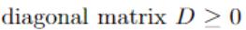
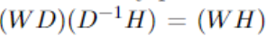
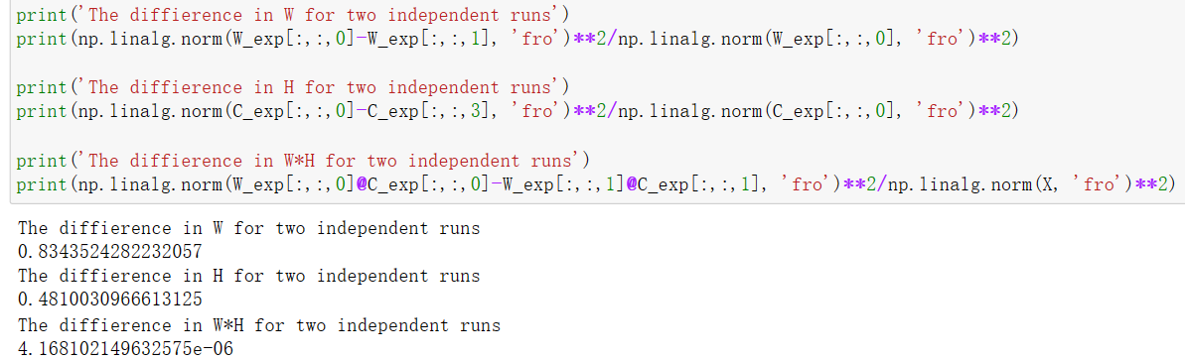
Non-unique solution
Notes:
It sounds good, but one issue, no unique solution.
Which means the W, and H could be transformed if we run the solver another time.
Although the error doesn’t change, the outputs totally change for different experiments even if the dataset is the same.
That makes the output for different experiments runs different, even though the dataset is the same.
For example, we take a single course in Loncapa exam. , the output of W and H are totally different. But the multiplication doesn’t change, they are roughly the same because they yield similar error.

Slide 16
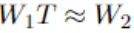
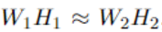
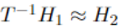
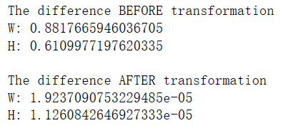
Transformation matrix
Transformation
Find T, s.t.
Notes:
But since the multiplication of W,H doesn’t vary too much in different runs, find a transformation matrix back.

Slide 17
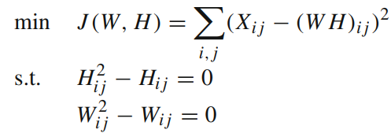
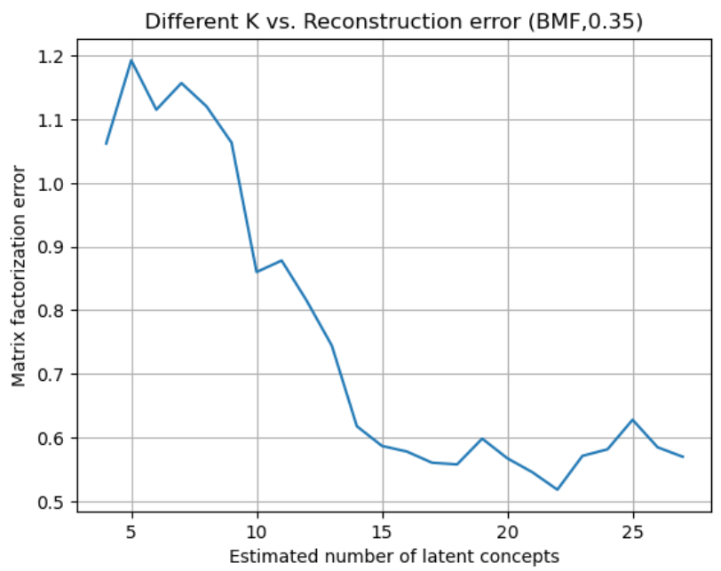
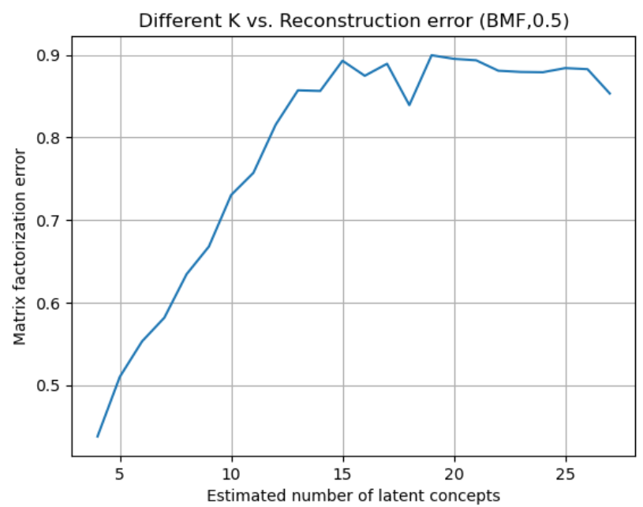
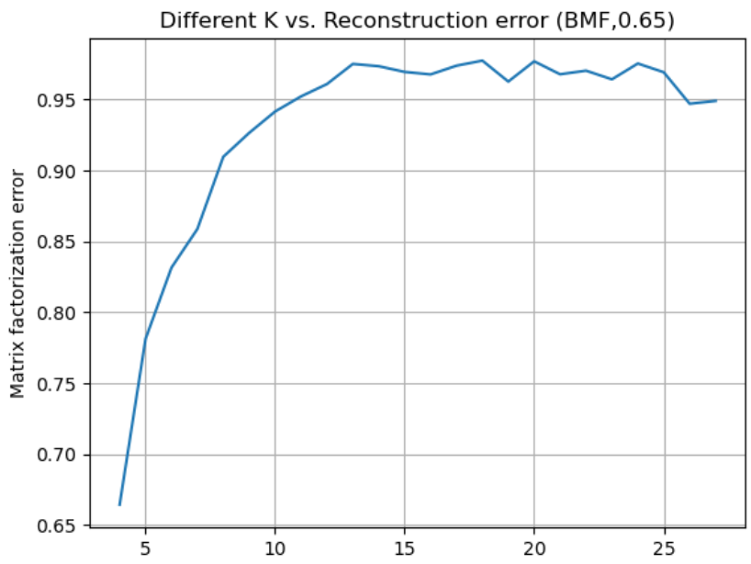
Binary Matrix Factorization (BMF)
OR
Thresholding
https://ranger.uta.edu/~chqding/papers/icdm07-binary.pdf
Notes:
I would using BMF by simply thresholding does not perform as good as NMF

Slide 18
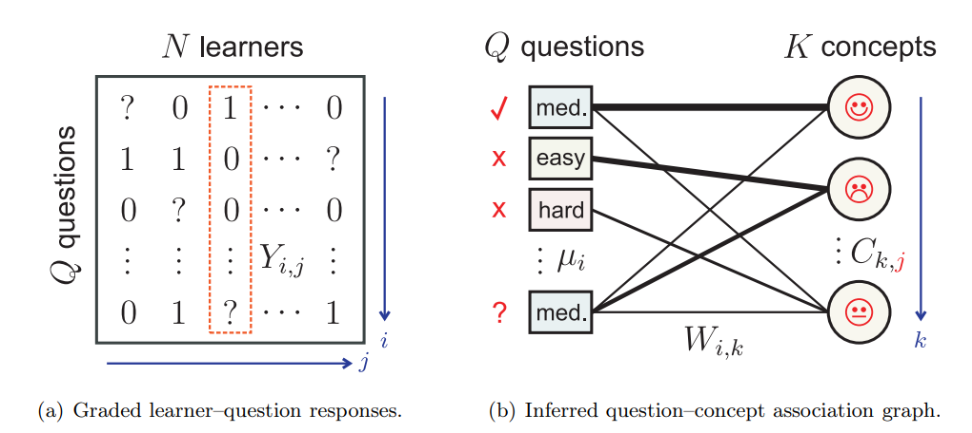
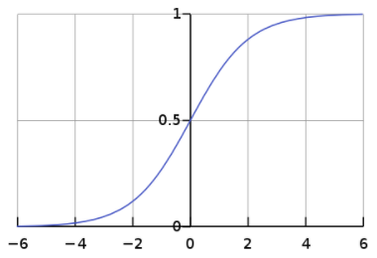
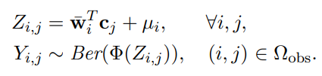
Sparse Factor Analysis (SPARFA)
https://www.jmlr.org/papers/volume15/lan14a/lan14a.pdf
Notes:
Add a sigmoid function on top of matrix factorization, (convert any real number into a number between 0-1，can be viewed as probability of getting question correct.) add regularization term and apply SGD to optimize the cost function.
Because there code is not open-sourced, we actually spent quite a lot of time implementing the alogrithms, but we cannot match the results they said. We can achieve relatively similar reconstruction error. But regarding the non-uniqueness issue, they report a low difference between W in different experiment runs, but ours are a bit higher. Anyways, still there are non-uniqueness issue if you want to use this type of methods as an estimator of student knowledge state.

Slide 19
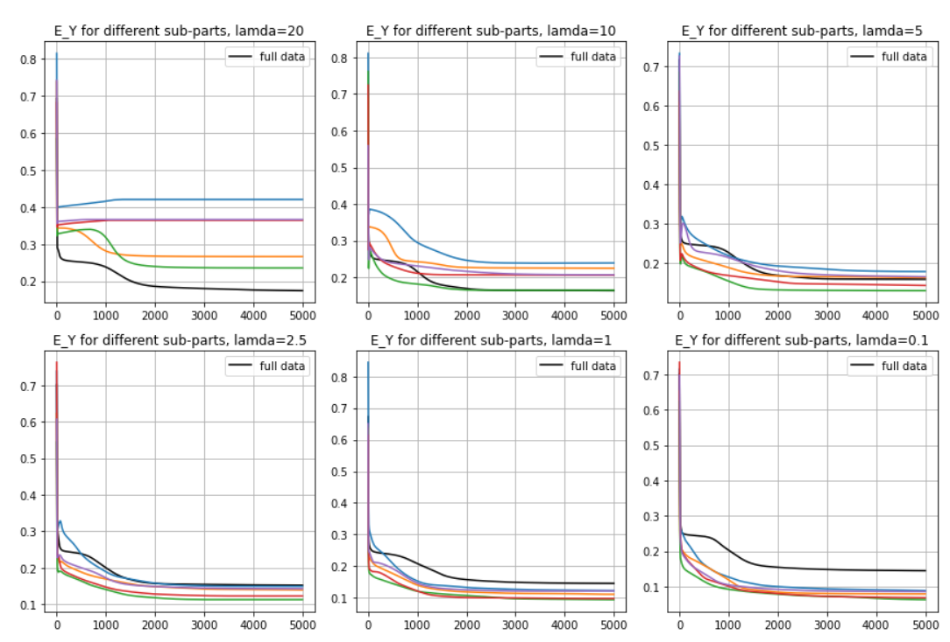

Slide 20
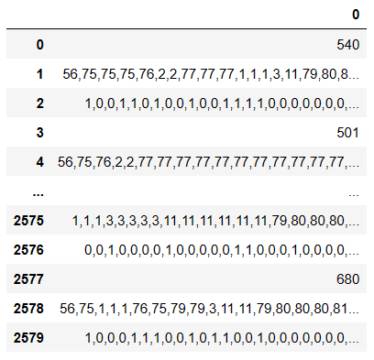
Homework mode (LonCAPA)
Learning sequence length
Student
Question ID
Right / Wrong
Characteristics:
Temporal information (usually happens in online learning with immediate feedback)
Each student has different and long learning trajectories (personalized learning)
Each question might appear multiple times; some non-feedback materials also appear
LonCAPA course 4 homework
Notes:
Here is all about MF
We also have another mode in LonCapa, After processing the dataset, we can formulate it into this format.
This time, students have learning sequence, and they solve different exercises in a time order
It has different characteristics compared to exam mode

Slide 21
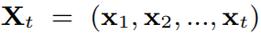
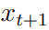
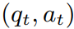
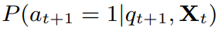

Knowledge tracing for recommendation
Historical interactions
Next interaction
$$≔$$
Markov process method (e.g., BKT)
Logistic regression method (e.g., IRT, PFA)
Deep learning method (e.g., DKT, DKVMN, Deep-IRT)
Notes:
xt is a tuple (qt, at)
The reason we want to use knowledge tracing is that we want 1. estimate student knowledge state when the dataset contains temporal info. Or . we need to be able to predict student future performance based on past trajectory so that we can design recommendation policy

Slide 22
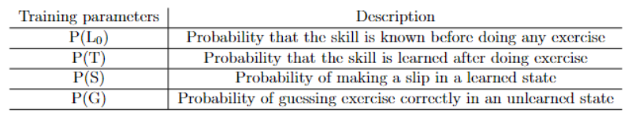
Bayesian Knowledge Tracing (BKT) -- Markov process method, baseline
Initial
BKT models a learner’s latent knowledge state as a set of binary variables
1-P(L0)
P(L0)
1-P(T)
1
Unlearned
P(T)
Learned
P(G)
1-P(G)
1-P(S)
P(S)
✓
✗
✓
✗
Notes:
Based on Markov process. Model a question learning process as a Markov process, with some observed state and hidden state. . In BKT, four training parameters per question. L,T,S,G
Initially you have a state L0, and you have a possibility of being learned or not-learned at initial point. Then you will answser question, and have a possibility P(T) of transiting from unlearned to learned state. Based on the result/observation (correct,incorrect), the BKT will update the posterior probability of knowledge state.

Slide 23
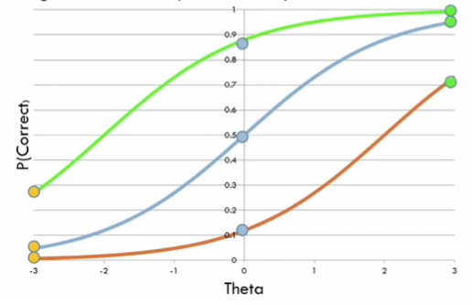
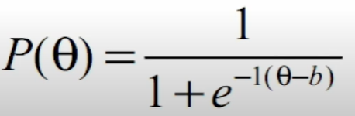


Logistic regression method (e.g., IRT, PFA, DAS3H)
Item response theory (IRT)
Each learner has ability $θ$
Each question has difficulty b
Green line: b=-2 (easy question)
Orange line: b=2 (hard question)
three parameter logistic model (3PL) :
Notes:
The simplest model of IRT has two parameters to fit. You will calculate the possibility of getting question correct based on ability and difficulty.
In the machine learning perspective, LGR method: estimate student performance by learning a logistic function (using different input features for different methods), Trying to find the parameters that best fit the observations
Estimate knowledge and difficulty together. After that, give item difficulty estimate, we can assess a student knowledge
, you are essentially learning a logistic regression network with different input features.
We fit logistic regression models by maximizing the likelihood of the training set
Can be fit by EM method

Slide 24


Deep learning methods
X₀
Y₀
Recurrent Neural Network (RNN)
X₁
Y₁
Feedback loop
Hidden state
encodes information about past trajectory
X_{T}
Y_{T}
Notes:
The earliest deep learning methods for knowledge tracing use a network called RNN (quite common in NLP).
RNN: normal network + feedback loop
Right pic: Unrolled version of RNN. They are equivalent.
This why RNN, because its nature has the ability to learn past information

Slide 25



Deep Knowledge Tracing (DKT)
Input sequence Output sequence
X_{t} (Input): past learning trajectory
y_{t} (Output): a vector representing the probability of getting each of the exercises correct
Sequence length (T) :
The number of previous steps being correlated
Notes:
Knowledge tracing using deep learning based method is called DKT. It was proposed in 2015, and the first DKT method uses vanilla RNN
One important param in RNN (sequence length):
Input: the combination of which exercise was answered and if the exercise was answered correctly
Output: For each student, we can predict from time 0 to T, his/her probability of answering each question correctly

Slide 26





Other variants of deep learning methods
Dynamic key-value memory networks (DKVMN)
DKT-Forget
Self Attentive Knowledge Tracing (SAKT)
Deep-IRT
Adversarial training based KT method (ATKT)
Knowledge query network (KQN)
Separated Self-Attentive Neural Knowledge Tracing (SAINT)
Graph-based Knowledge Tracing (GKT)
$$⋮$$
Notes:
Following that DKT, Thery are a lot of modifications of network achitectures to become different models.
The input and the ways to pre-process inputs are the same, just the training network structures has changed.

Slide 27



Knowledge tracing dataset
Notes:
Ok, I have introduced all three main categories of knowledge tracing methods, lets see the experiment results. We run different models on different open datasets and our own Lon-capa. Here is the statistics of the datasets for your information.
Some literature doing Benchmarking on all open datasets, and compare and analyze the detailed characteristics of each open dataset and how these relate to knowledge tracing performance and model selection. I don’t have time to discuss this into detail but I would refer you to the appendix in the slides for more info

Slide 28


Evaluation metric: Area Under Curve (AUC)
performance of a binary classifier with different decision thresholds
AUC metric: Area under ROC curve
Notes:
Plot the value for a binary classifier at different thresholds, you get ROC curve, and the area.. .AUC is a general metric to evaluate the performance of binary classifier (label is correct, incorrect, essentially training a binary classifier)
Middle line corresponds to random guess, worst case, our model doesn’t do anything. The best score is 1, the higher the better.
As you try to increase the TPR (i.e., correctly identify more positive cases), the FPR may also increase (i.e., you get more false alarms).

Slide 29


Experiment result (Knowledge tracing)
Notes:
Do a sanity check. We run different knowledge tracing models from three categories on some of the open datasets as well as our Lon-Capa. The evaluation metric is AUC score, which is commonly used in machine learning. It can evaluate a performance of a binary classifier. The worst score is 0.5 (random guess)
Focus on Knowledge tracing models on our dataset， >0.5, good, saying that all the models can somehow predict the future performance on our dataset (dataset is reasonable). The comparison across dataset quality sometimes does not make sense.

Slide 30
Sequence length and test performance
Dataset Sequence length
475.8 ±174.6
673.7 ±223.5
LonCAPA historical information is helpful for future prediction
Notes:
We also discuss how the performance changes as we change the sequence length in dkt (how many past steps are taken into account in the network training)
as the sequence length increases, the AUC score also gradually improves and levels off
As we take into account more past steps, the performance becomes better, meaning that at least there is not too much noise in the dataset such that we can actually learn a pattern from past info.
until the sequence length is approximately half of the daverage total sequence length.

Slide 31


Conclusion
Matrix factorization
NMF
No temporal/dynamic information
Each student answers similar number of questions only once (e.g., midterm exam)
Might have missing entries
BMF
SPARFA
Non-unique solution !!
$$⋮$$
Temporal information (e.g., online learning, self-tutorial)
Each student has different and long learning trajectories (personalized learning)
Each question might appear multiple times; some non-feedback materials also appear
Knowledge tracing
BKT
IRT/PFA
DKT
$$⋮$$
Hidden state not explainable

Slide 32
Conclusion
LonCAPA historical information is helpful for future prediction !
LonCAPA dataset is suitable for knowledge tracing tasks!
We can use knowledge tracing models to build a student simulator for RL based recommendation system

Slide 33


Future work
Quantitively compare LonCapa vs open datasets. What it looks like on a real-classroom dataset ?
Combine Knowledge tracing with Matrix factorization
Construct a student simulator (Large language model)
Learn a recommendation policy using deep RL and evaluate it using simulator
Notes:
Use DKT to discover latent structure, and then cross-validate with NMF.
Here, suggested reward function and action-value function in another literature

Slide 34

Thank You!

Slide 35

LONCAPA dataset

Slide 36


The W matrices are different for different runs, even though the reconstruction errors are roughly the same

Slide 37


SPARAF-metrics
Random initialization of 25 experiments on Lon-Course1
Notes:
See the difference towards sparce coding
Assume we know W, try to see if we can get a better C_est
Include tag analysis
Split students in a same course into multiple groups, check if the W_hat are similar among this group. Change lamda, gamma, and see if the result are concentrated to W_gt
Try deep learning neural network.

Slide 38

Bayesian Knowledge Tracing (BKT) update rule

Slide 39

Item response theory (IRT)

Slide 40

One-hot encoding
Indicating the state of a state machine
In NLP, a one-hot vector is a 1 × N vector used to distinguish each word in a vocabulary from every other word in the vocabulary
The vector consists of 0s in all cells with the exception of a single 1 in a cell used uniquely to identify the word.

Slide 41

DKT using RNN
Prediction: torch.size (n_students, sequence_len, n_ques) – For each student, we can predict from time 0 to T, his/her probability of answering each question correctly

Slide 42

External dynamic memory matrix – value matrix
Knowledge state of a student towards concepts
Static matrix– key matrix
Relationship between latent concepts and questions
Dynamic key-value memory networks (DKVMN)
Notes:
One drawback: hidden state is not physically explainable. What is the physical meaning of values in the hidden state.
Still not that explainable, people are working into that direction.
For example, combine this with IRT.

Slide 43

Attention mechanisms, Transformer
New question (query)
Similarity between the query
(question embedding)
Similarity with the past data
(interaction embedding)
Self Attentive Knowledge Tracing (SAKT)
Convex combination of past data
https://www.youtube.com/watch?v=zxQyTK8quyY
Notes:
In some datasets, they can improve to some extent.

Slide 44
The size of a dataset (the number of learners per question and per Knowledge concept)
logistic regression leads on small datasets because DKT severely overfits
The degree to which learners progress sequentially through the material, as opposed to switching between different topics every question
DKT leads on these sequential datasets because it can better exploit precise temporal information than competing approaches
The number of interactions per learner
DKT lags behind other approaches on datasets with large num_inter per student as it struggles to keep track of long-term information, whereas approaches operating on a feature vector of historical counts (like logistic regression) sidestep this issue
Notes:
Hand design some features for logistic regression
Run a model for 1000 epochs
Add a pretrained embedding layer
DKT on exam

Slide 45


Slide 46

LonCAPA-df1
1399954
2080
720
--
--
1480.5
✓
662.5
Correct rate:
37.1% for df1, 37.7% for course4
Notes:
1. Toolbox section
2.Qualitative comparsion of loncapa vs open datasets. What it looks like on a real-classroom dataset.
3.Maybe combining CF with KT.
Use SPARFA just as a state estimator, and compare with convex/non-convex opt method
Use SPARFA as a recommender, but no guarantee
Use deep learning as a recommender, but only have relatively small dataset for Loncapa
Use Bayesian knowledge tracing for small dataset (offline learning scenario)

Slide 47


Question embedding and test performance
AUC of Lon-Comb, no embedding
AUC of Lon-Comb, with embedding

Slide 48



Assistant 2015
(large dataset)
DKT with one-step input
DKT
Logistic regression

Slide 49


Assistant 2017 (large dataset)
DKT with one-step input
DKT
Logistic regression

Slide 50



KddCup (small dataset, large number of interactions per learner)
RNN with one-step input
DKT
Logistic regression

Slide 51


